Slide 1
Operational Amplifiers
Or, “Op-Amps”
Presented By:
Mark Thoren
Principal Engineer, System Design / Architecture
Notes:
This is the light cover slide option.

Slide 2
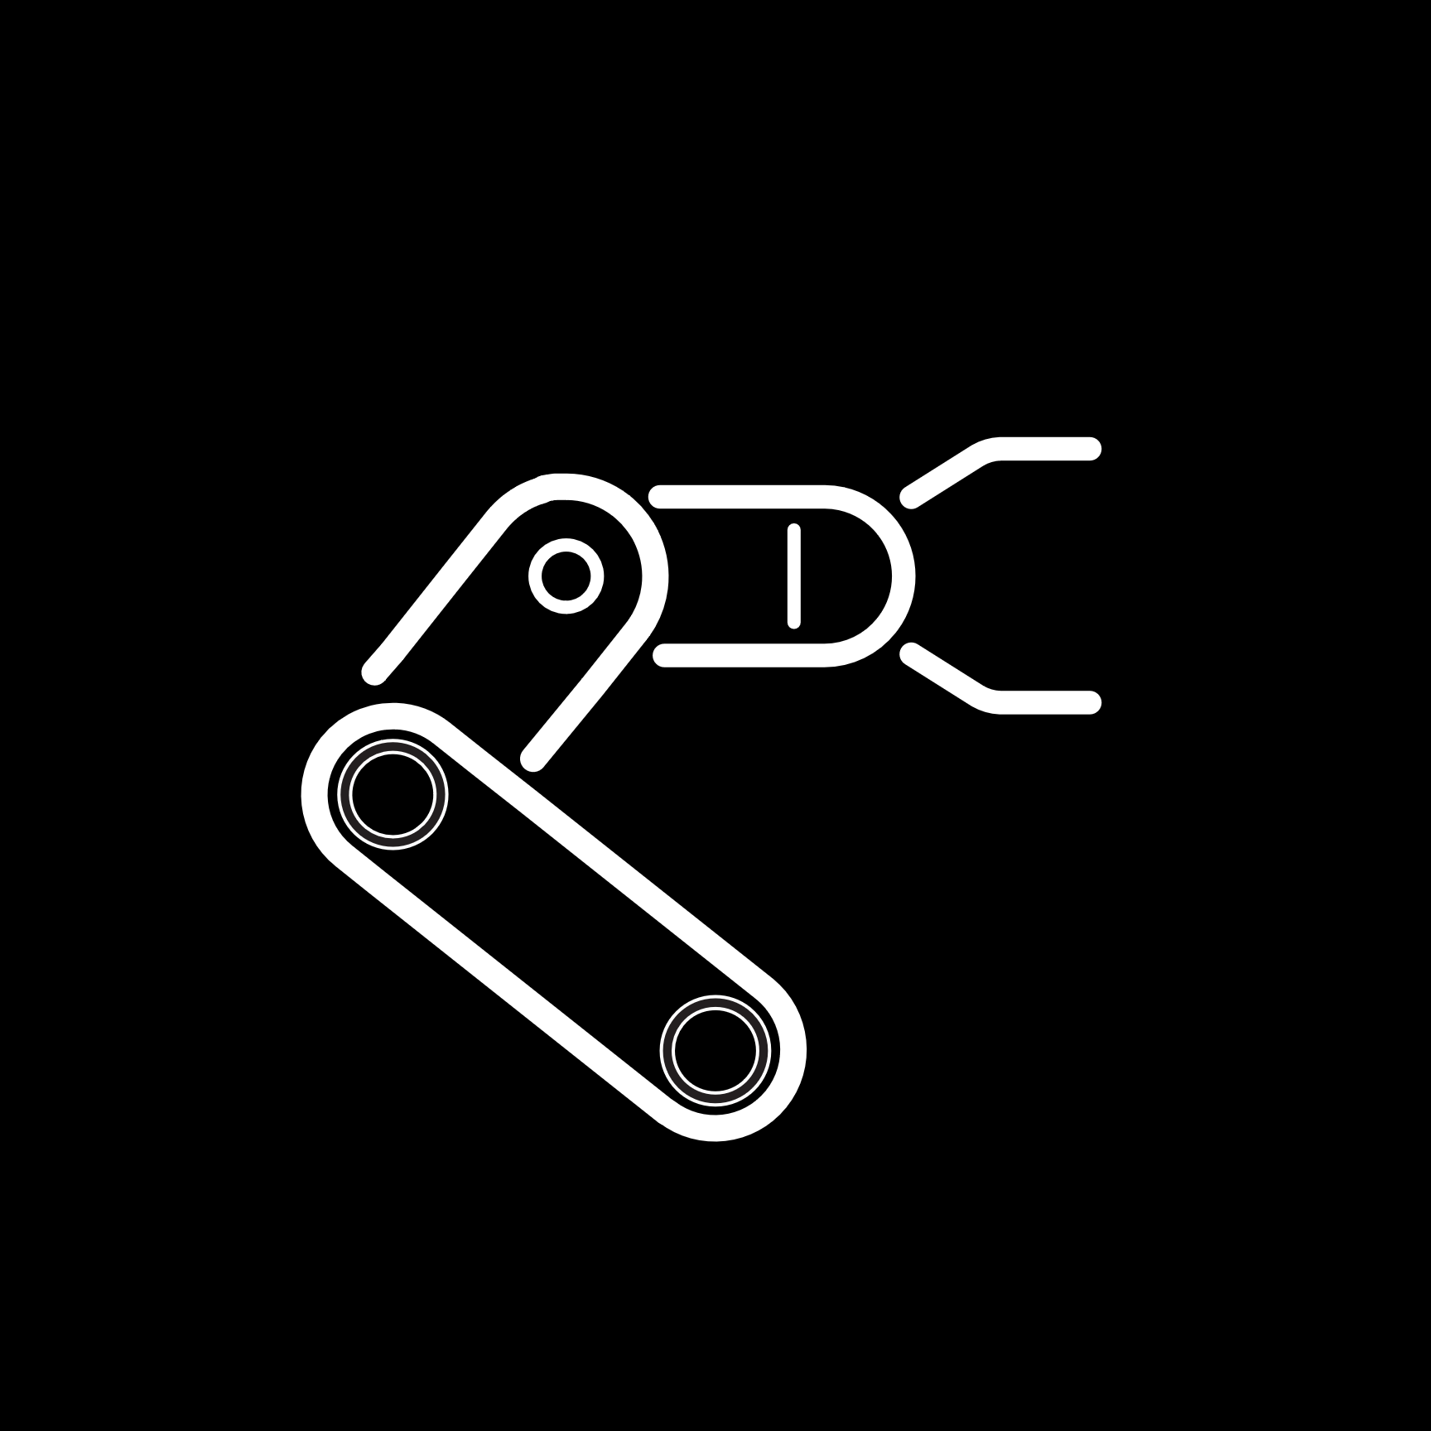





Leading Technologies Across Applications
v
Solving complex design challenges from DC to 100 GHz,
nanowatts to kilowatts,
sensor to cloud across diverse markets
v
Digitized Factories
ANALOG & MIXED-SIGNAL
Converter, Amplifier, Interface
Automotive Ecosystems
POWER MANAGEMENT
Voltage Regulator, PMIC, Supervisory
Communications & Cloud
KEY GROWTH DRIVERS
Digital Healthcare
RADIO FREQUENCY (RF)
Mixers, Amplifiers, Filters
Immersive Consumer
EDGE PROCESSORS & SENSORS
DSP, MCU, Inertial, Optical
Aerospace

Slide 3
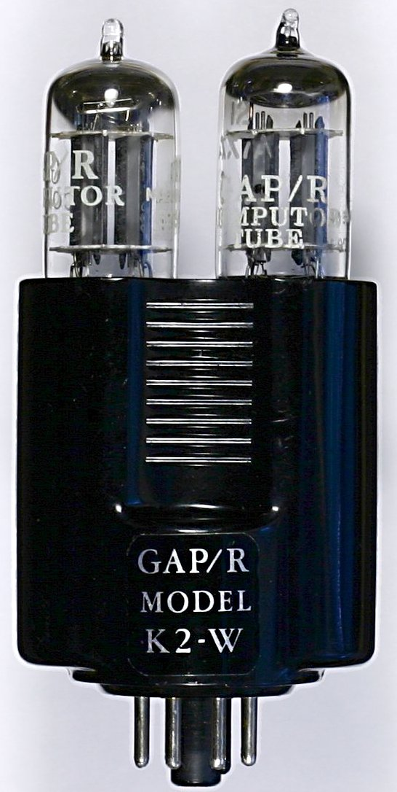
What Is an Op Amp?
High gain, DC coupled amplifier
Differential input, single ended output
High input impedance, low output impedance
“fast”, but not infinitely fast – needs a specification
Op Amp, circa 1952
Notes:
Philbrick GAP/R, named after George A. Philbrick Research (thus GAP/R). Bob Pease is an alumnus.

Slide 4
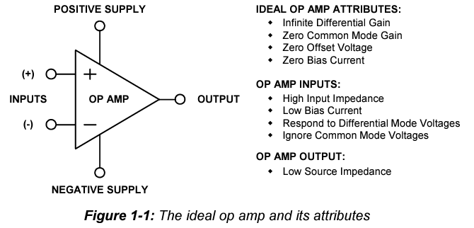
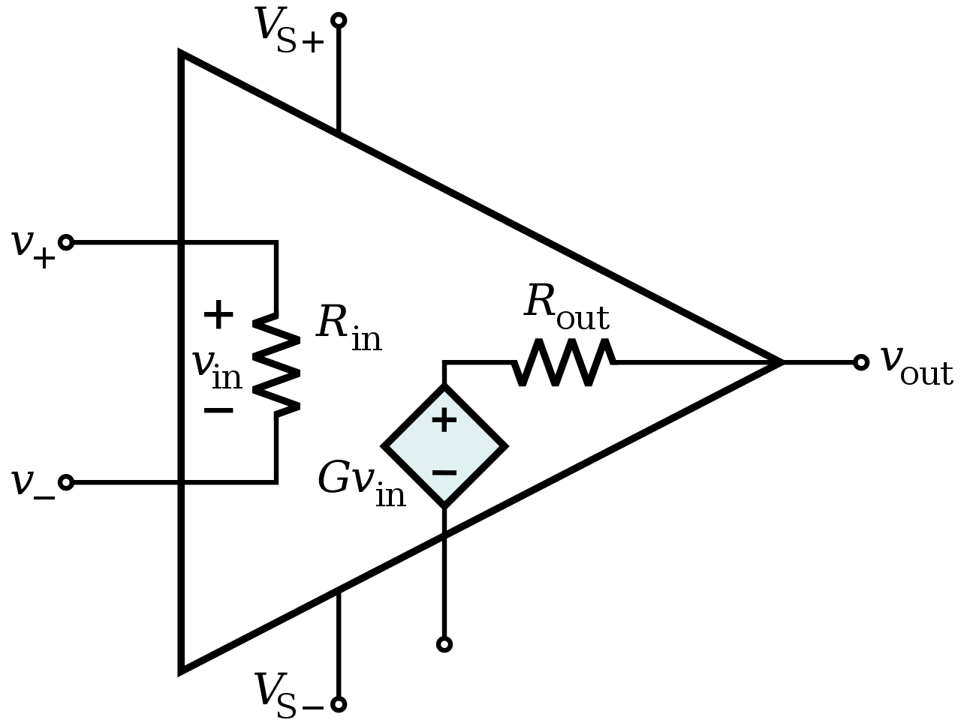
You have seen this before…
Notes:
Image source: https://upload.wikimedia.org/wikipedia/commons/thumb/0/0d/Op-Amp_Internal.svg/1280px-Op-Amp_Internal.svg.png

Slide 5
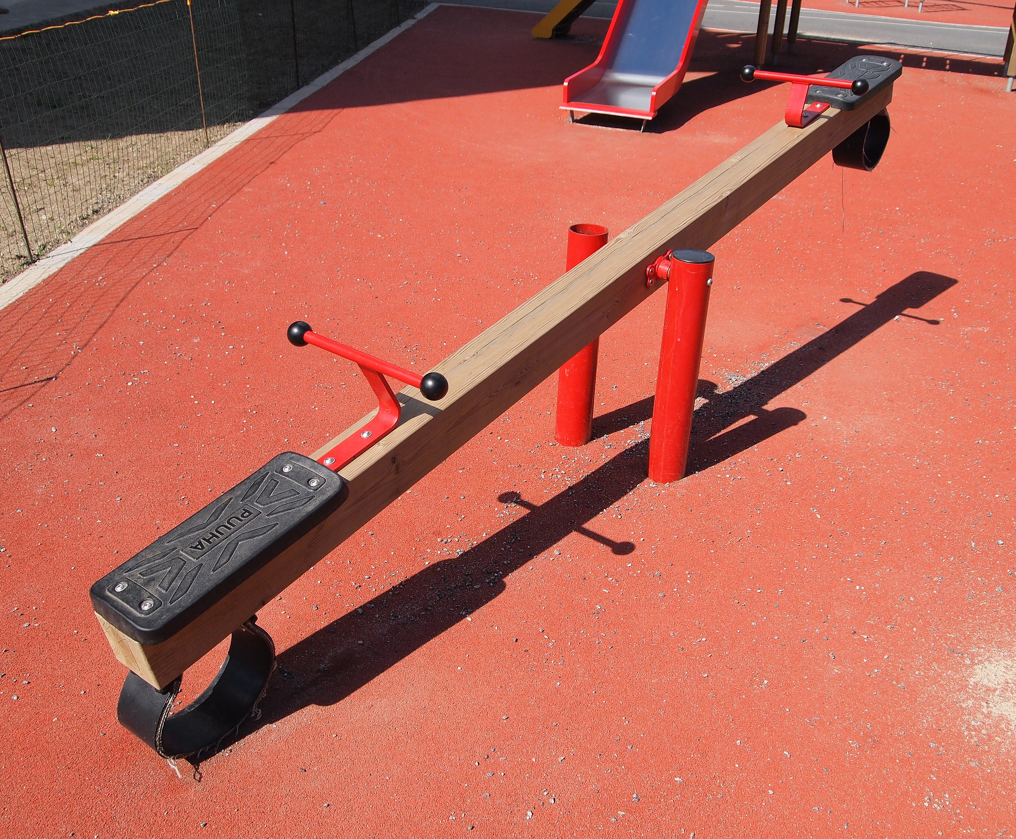
Isn’t there a more intuitive model?
In many applications, it can be viewed as an electronic See-Saw!
(Think of DISPLACEMENT as the voltage, not the force.)
Other terms:
Teeter-Totter
Wippe (German)
Balancín (Spanish)
Leagan (Romanian)

Slide 6
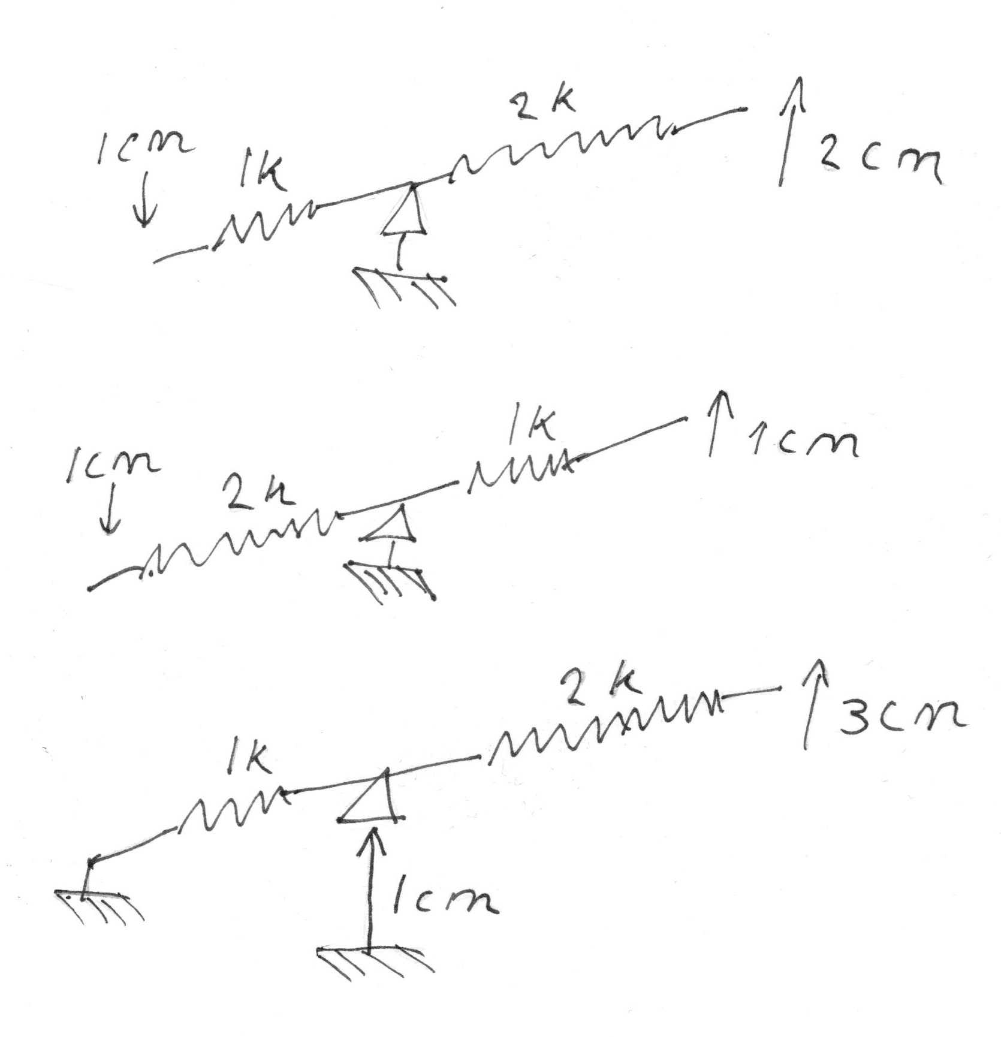
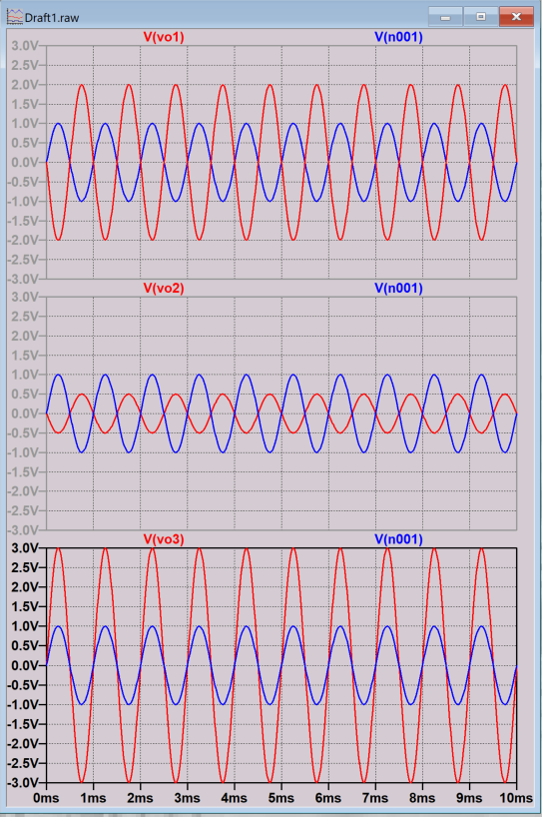
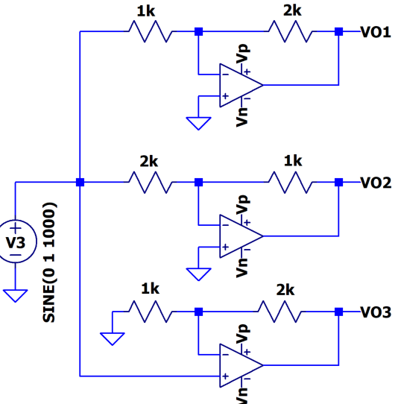
Seriously? It works??
0.5
Notes:
Lots of visualizations on the internet:
https://www.allaboutcircuits.com/textbook/semiconductors/chpt-8/an-analogy-for-divided-feedback/
I sort of messed up on the last one – technically the left-hand side of the seesaw is the fulcrum. But you get the idea.

Slide 7
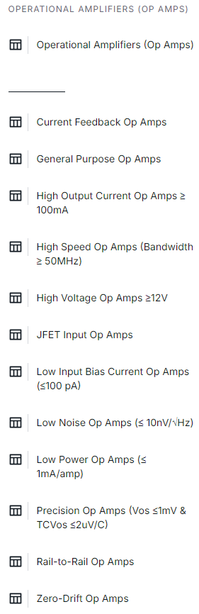
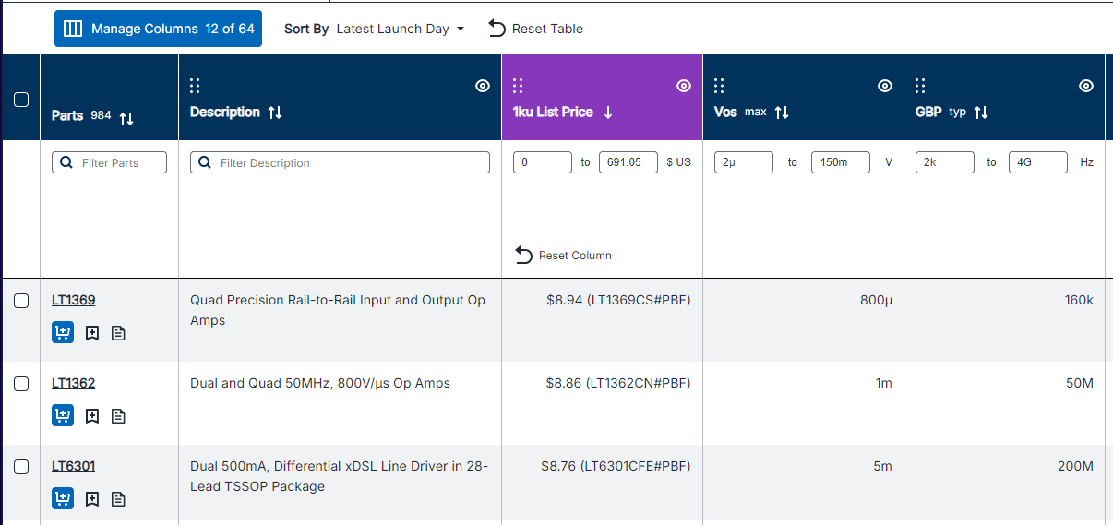
Don’t we have enough op-amps already?
Isn’t all the business SoCs or ASSPs, where everything is integrated into a single chip?
“Nobody uses analog anymore, so why does this even matter?”
I haven’t seen an 8-pin DIP in years. Do they still exist?
Notes:
Go through this one pretty quickly…

Slide 8
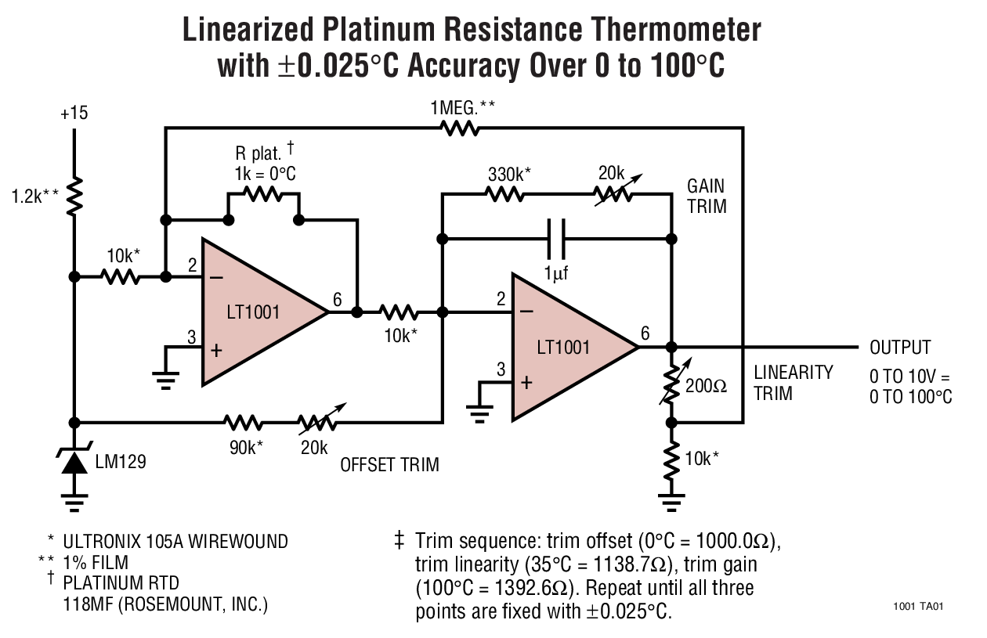
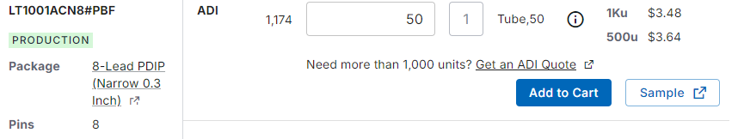
Who Buys op-amps?
Old guys with gray beards
But also… customers that have:
Analog performance requirements not available in highly-integrated SoC solutions
For example, SoC/µC with 0-3.3V DAC output, application requires +/-10V
New applications that don’t have SoCs available (yet)
Smaller volume applications that will never have SoCs available
These are lucrative, long-lived sockets.
The LT1001 was designed in the early 1980s, is still in production, and we still get $3.50 for it!
This is why we care
Notes:
Modern fine-line CMOS can’t do traditional high-performance analog

Slide 9
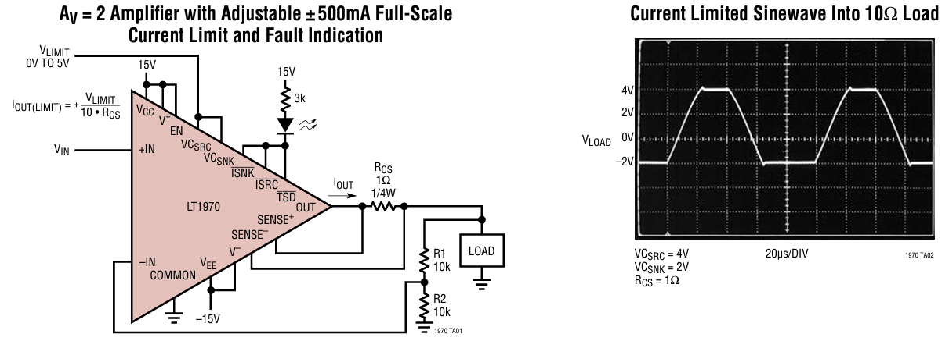
Not all op-amps are created equal
Part Number: | LM324 | LTC2057 | ADA4895-1 | LT1970
Offset | 3 mV (3000 μV) | 4 μV (tiny!) | 350 μV | 200 μV
Open-loop gain | 50,000 (94 dB) | 30 million (150 dB) | 300,000 (110 dB) | 120,000 (102 dB)
Gain-Bandwidth Product | 1.2 MHz | 1.5 MHz | 2 GHz | 3.6 MHz
Supply V range | 36 V | 60 V (H-version) | 3 V – 10 V | 36 V
Output Current | 30 mA | 5 mA | 100 mA | 500 mA
Special Features | Cheap! | Accurate! | Fast! | Lots! (see figure)
LT1970:
+/-500 mA w/ precise limit
Built-in current sense
Overtemp, overcurrent indicators
Thermally enhanced package

Slide 10
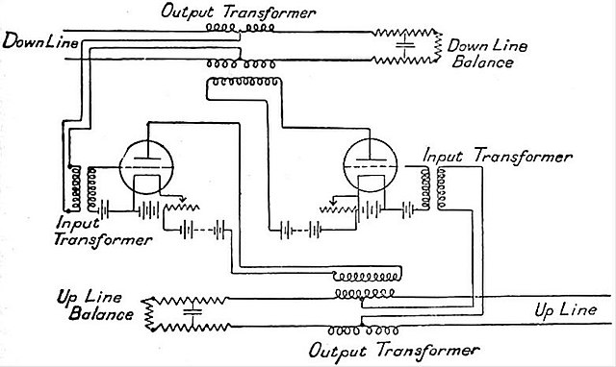
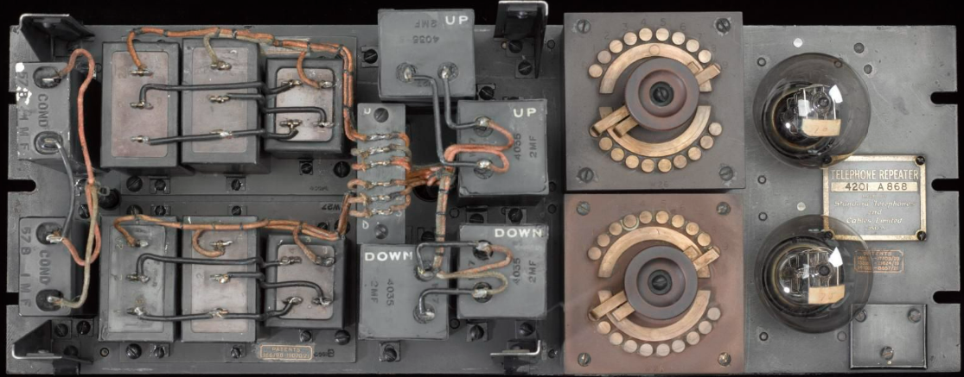
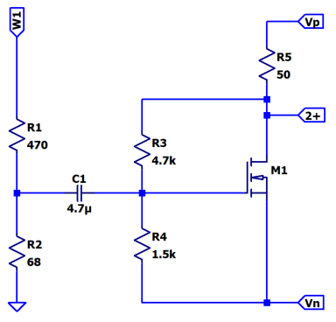
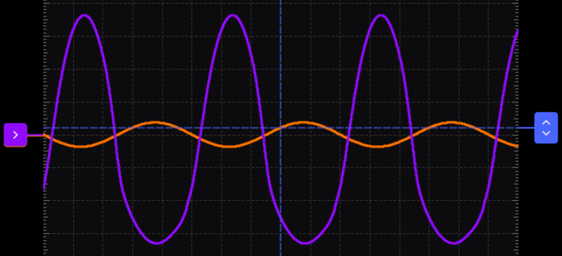
So… what came before “operational amplifiers”?
Yup, you guessed it… “amplifiers”!
Key spec of an amplifier (of the time) was gain… more is better, right?
Except when it’s distort-y, inconsistent, and has terrible frequency response.
Triode – MOSFET analogy, you can build one!
Notes:
https://commons.wikimedia.org/wiki/File:EB1922_Telephone_-_Telephone_repeater_circuit.jpg
MOSFET Amplifier Lab: https://wiki.analog.com/university/courses/electronics/electronics-lab-5m

Slide 11
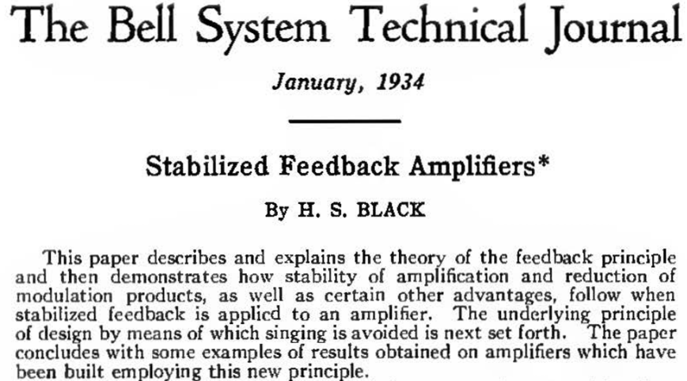
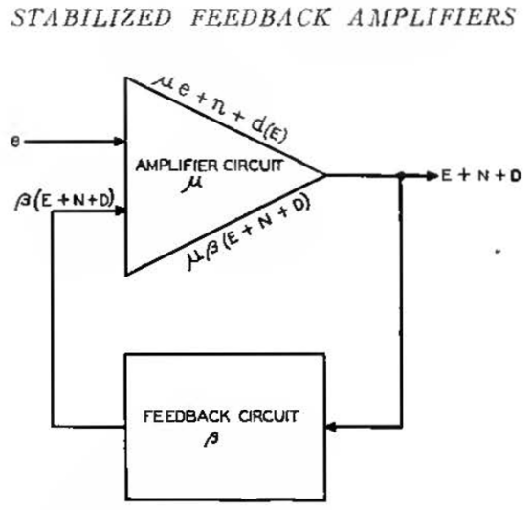
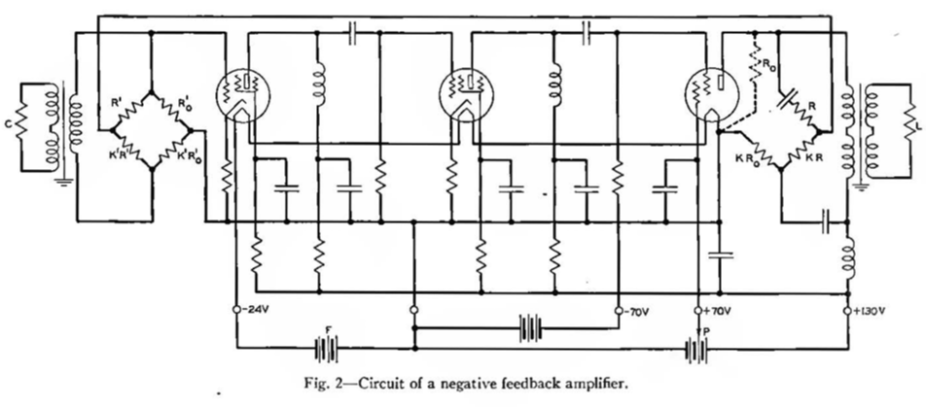
Enter: Negative Feedback
1934 Bell Labs, Harold .S. Black
“…by building an amplifier whose gain is deliberately made, say [a factor of 100] higher than necessary’ …, and then feeding the output back on the input in such a way as to throw away the excess gain, it has been found possible to effect extraordinary improvement in constancy of amplification and freedom from non-linearity.”
Notes:
It is hard to understate the importance of this paper ☺
https://convexoptimization.com/TOOLS/Black.pdf
https://en.wikipedia.org/wiki/Harold_Stephen_Black
https://www.diag.uniroma1.it/~oriolo/fda/matdid/Hist_BlackAmp.pdf
https://personal.utdallas.edu/~yxc101000/courses/4340/feedback.pdf

Slide 12
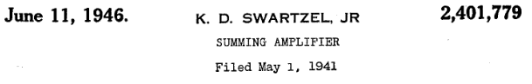
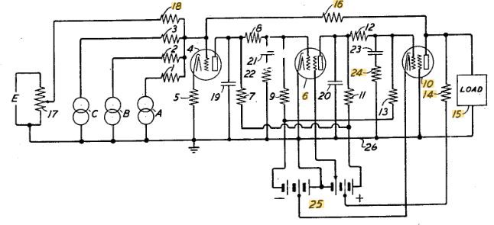
“Summing Amplifier” – closer to modern “op-amps”
1941 – Summing Amplifier patent
2401779A
Summing is an “operation”
Other “operations”:
Difference / subtraction
Integration (capacitor in feedback path)
Differentiation (cap in input path)
Exponentiation (diode in input path)
Multiplication / divisions (make from exp/antilog)
squaring / square-rooting (make from mult/div)
Notes:
https://patents.google.com/patent/US2401779

Slide 13
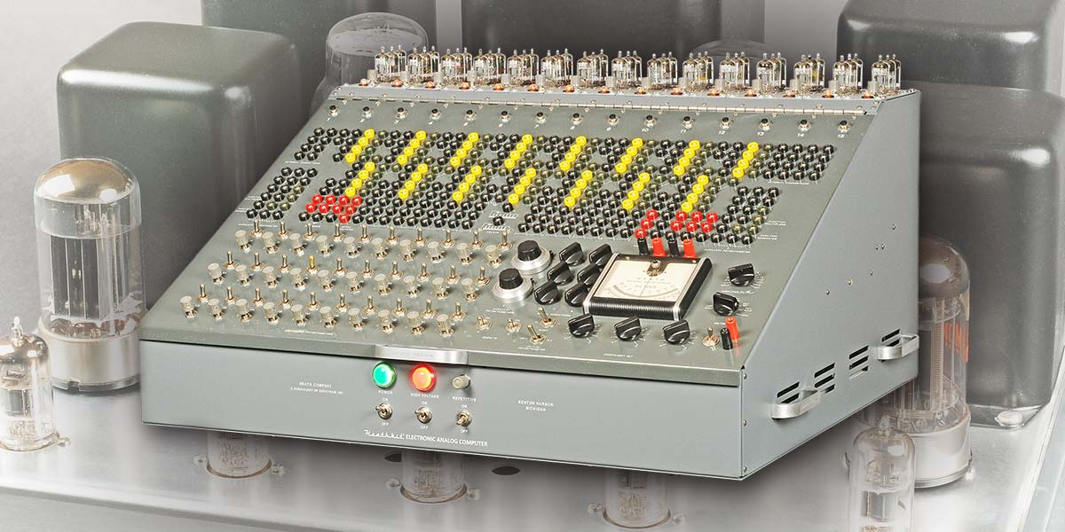
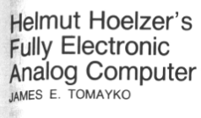
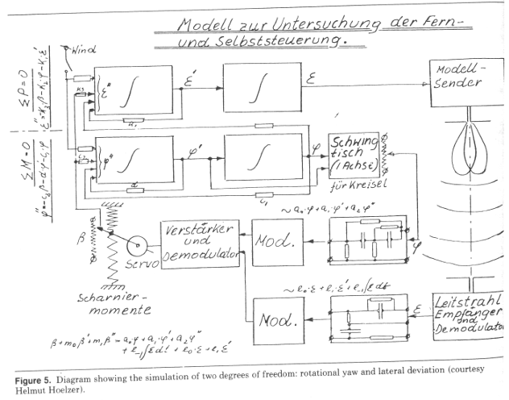
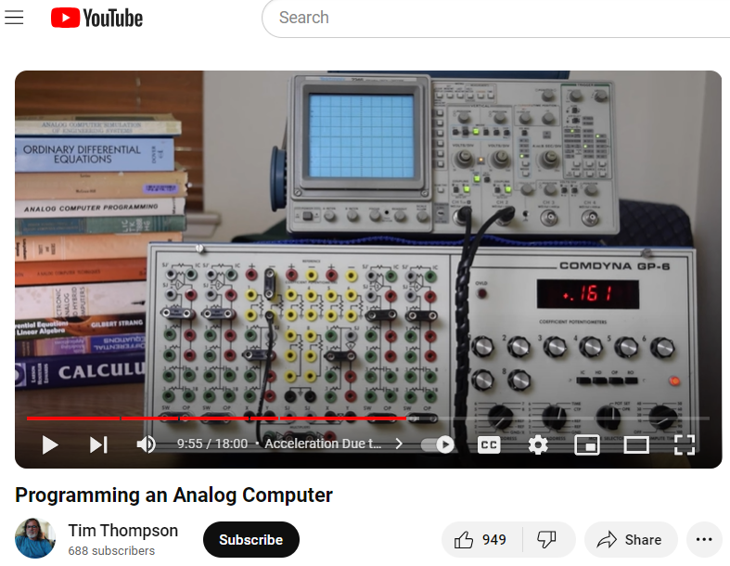
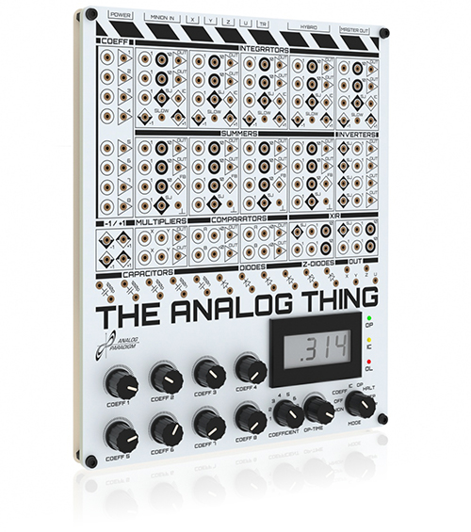
Analog Computers
Solving differential equations
Simulating dynamic systems
Missile control systems (of course ☹)
Of course there is a subculture that still builds them!
Notes:
Programming an Analog Computer: https://www.youtube.com/watch?app=desktop&v=3tOA8Fo6b7A
https://www.nonstopsystems.com/radio/pdf-hell/article-hell-DM12-400.pdf

Slide 14

LTspice What’s the point?
Is it a “Sanity Check”? (No, see a therapist.)
“That is how you verify the design” (No, you do that on the bench)
So what is the point?
“The point of simulation is so you understand your circuit better…To develop intuition… There is no way to understate the value of cultivating intuition about how your circuit works.”
https://www.youtube.com/watch?v=x6TrbD7-IwU
And it’s FREE!

Slide 15
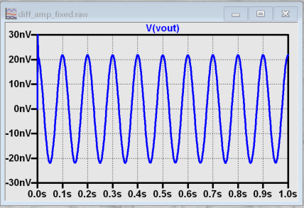
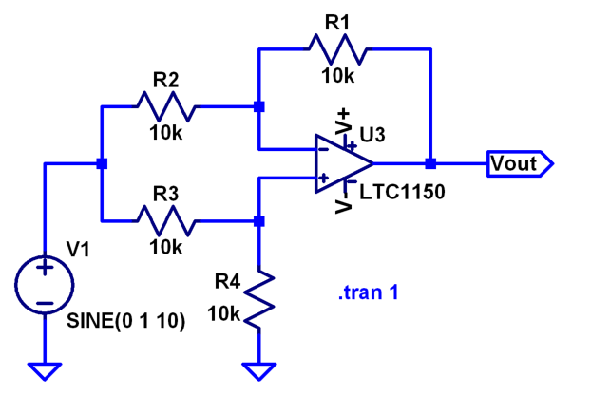
Intuition: Perfectly Modeling Imperfection
Difference Amplifier’s figure of merit – reject voltages common to both inputs (A and B)
Drive A and B with the same 1V sinewave, see what comes out…
A
B
Sweet!
20*log(1V/20nV)=153dB CMRR!
Notes:
A classic lab experiment is building a difference amplifier, where common-mode rejection ratio is dependent on resistor matching. Given that most parts kits have either 5% or 1% resistors, CMRR is typically not great. But a student can build intuition by modeling a perfect difference amplifier in simulation, then measure their actual resistor values with the school’s benchtop meter, enter the measured values into the simulator, and (hopefully) reconcile with their real-world measurements.

Slide 16
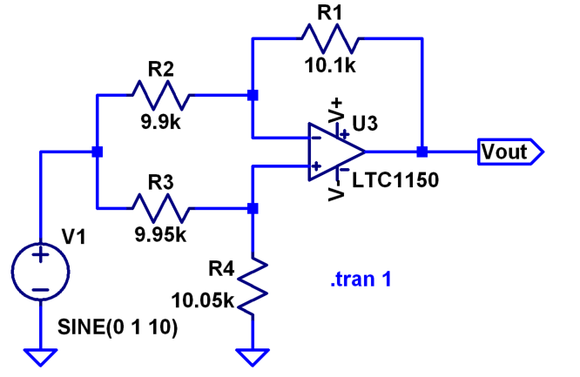
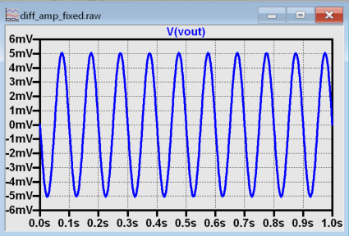
Sad reality ☹
Adding in measured resistor values
Simulation Doesn’t reflect the “real world”. But – being able to accurately model a circuit’s imperfections adds immensely to understanding.
Sad…
20*log(1V/5mV)=46dB CMRR
Notes:
A classic lab experiment is building a difference amplifier, where common-mode rejection ratio is dependent on resistor matching. Given that most parts kits have either 5% or 1% resistors, CMRR is typically not great. But a student can build intuition by modeling a perfect difference amplifier in simulation, then measure their actual resistor values with the school’s benchtop meter, enter the measured values into the simulator, and (hopefully) reconcile with their real-world measurements.

Slide 17
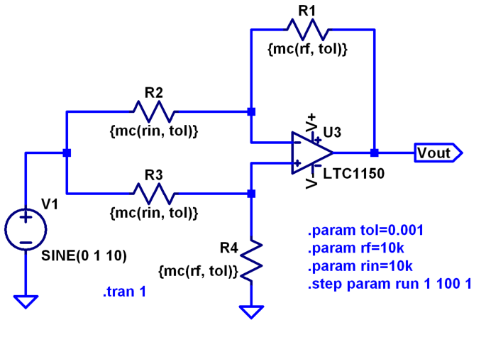
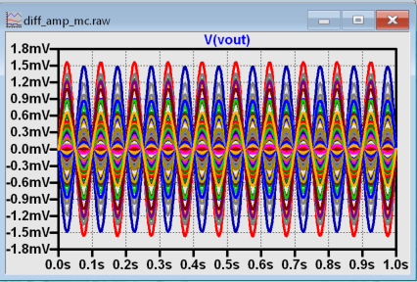
How many E.P.S* can you perform on the workbench?
* Experiments Per Second. Ltspice lets you do lots.
Monte Carlo: Getting a feel for what to expect.
(Yup, it is named after the casino)
A workable model that will keep you out of trouble:
Always bench test. Focus on corner cases. Purposely exercise worst case situations, even if you have to force them. Reconcile benchtop worst-case measurements with LTspice.
Finally – use LTspice confidently inside worst case.
Visual worst-case:
20*log(1V/1.5mV)=56dB CMRR
Notes:
The Beginning of the Monte Carlo Method: https://permalink.lanl.gov/object/tr?what=info:lanl-repo/lareport/LA-UR-88-9067
https://www.analog.com/en/technical-articles/ltspice-worst-case-circuit-analysis-with-minimal-simulations-runs.html

Slide 18
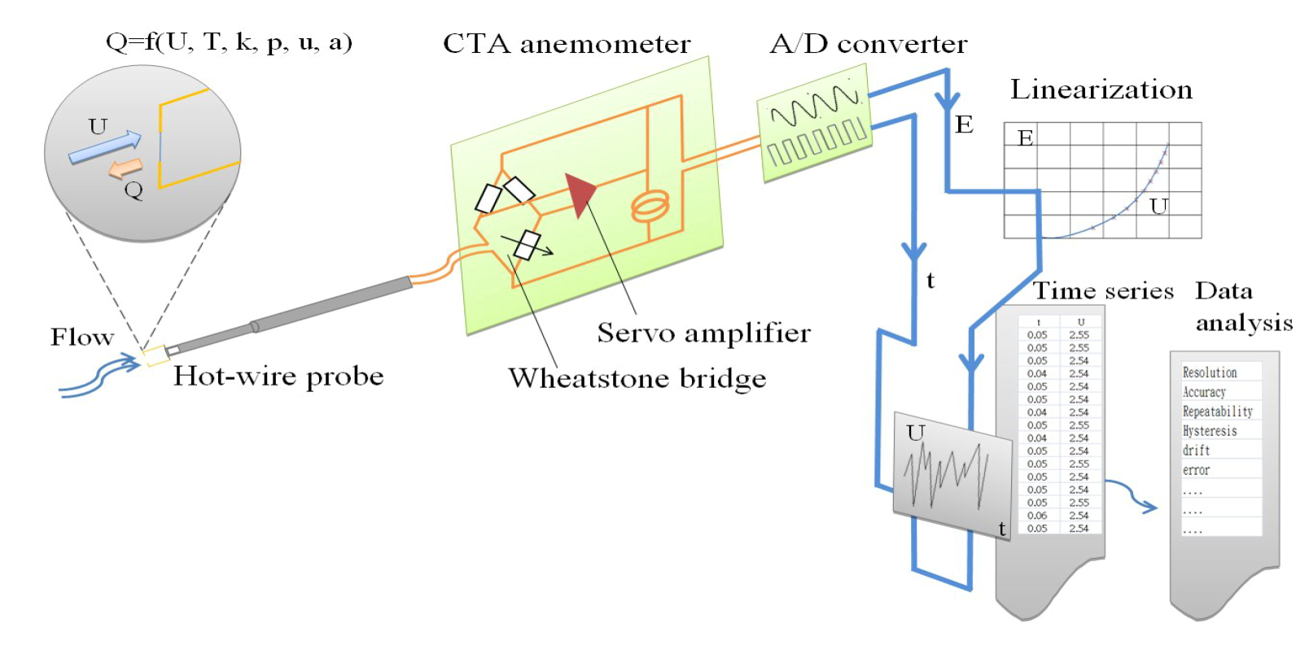
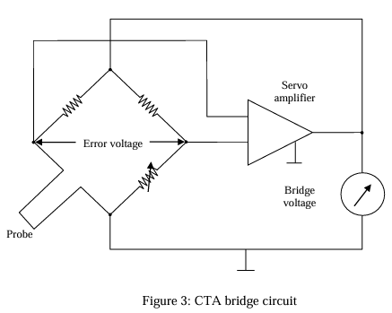
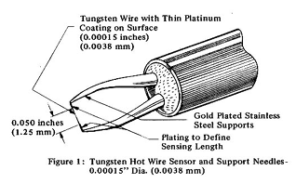
Cool Circuit U can build: Hot Wire Anemometer
Op-amp keeps the wire at a constant temperature
King’s law (approx.): Heat Transfer proportional to square root of flow
Yes you can use a cracked open incandescent flashlight bulb (be careful!)
Link to Virginia Tech lab exercise in notes
Notes:
https://www.eyc-tech.com/show/eyc-hot-wire-type-air-velocity-series-product-principle-application.htm
https://archive.aoe.vt.edu/simpson/aoe4154/hotwirelab.pdf

Slide 19
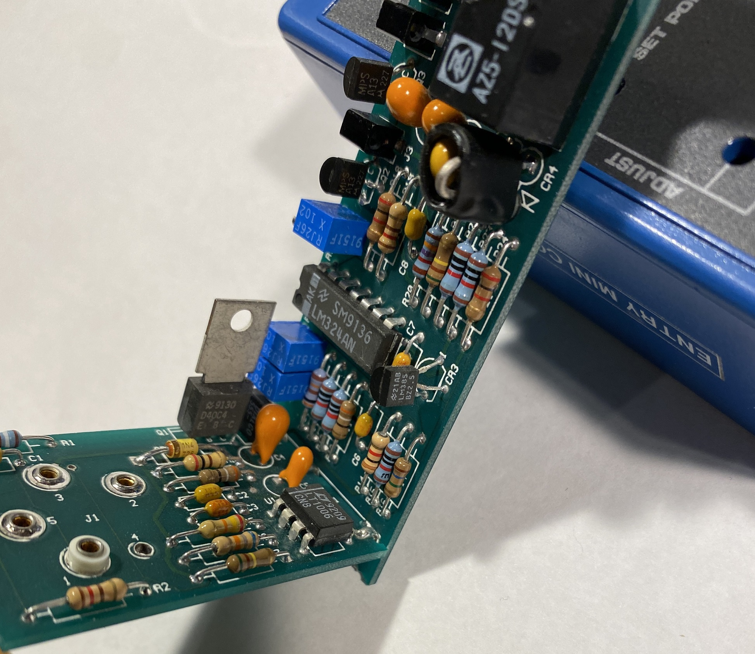
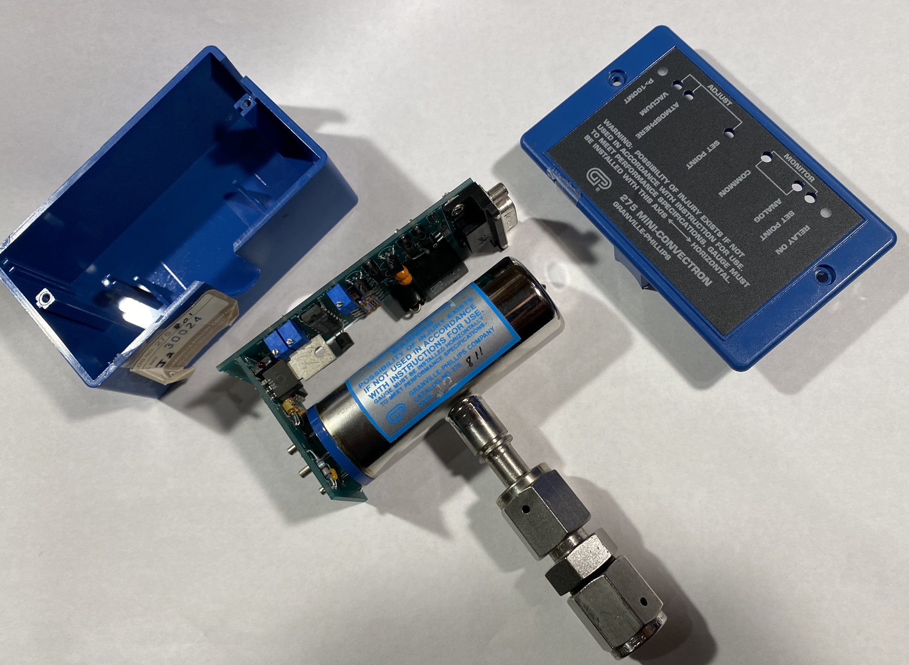
Product Example: Pirani vacuum gauge
Pirani gauge similar to hot wire anemometer
“There’s not a box made in the U.S.A. that doesn’t have an LT/ADI part in it.”
In this case, it’s a very shiny, very expensive box.
1992 date codes!
LM324 op-amp… cheap where performance doesn’t matter
LT1006 op-amp… Performance where it’s important

Slide 20
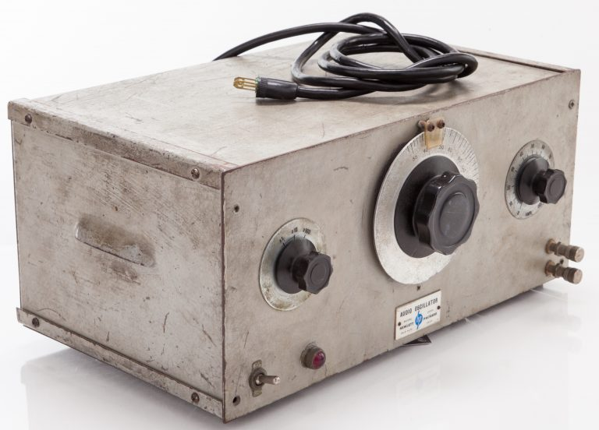
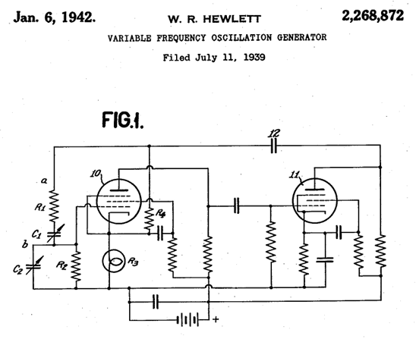
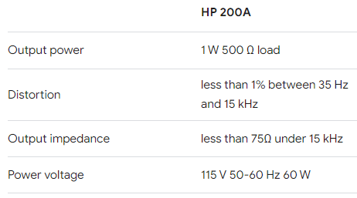
What was Hewlett Packard’s First Product?
Model 200A Audio Signal Generator
Bill Hewlett’s thesis available at:
https://www.kennethkuhn.com/hpmuseum/scans/

Slide 21
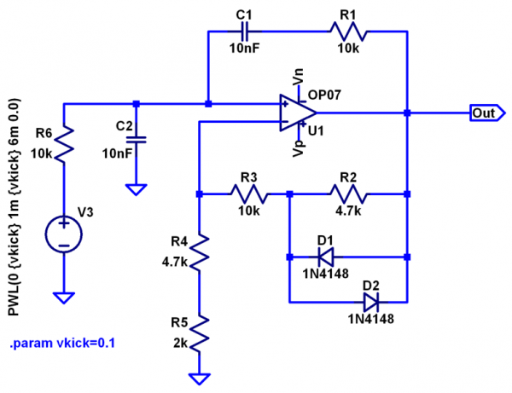
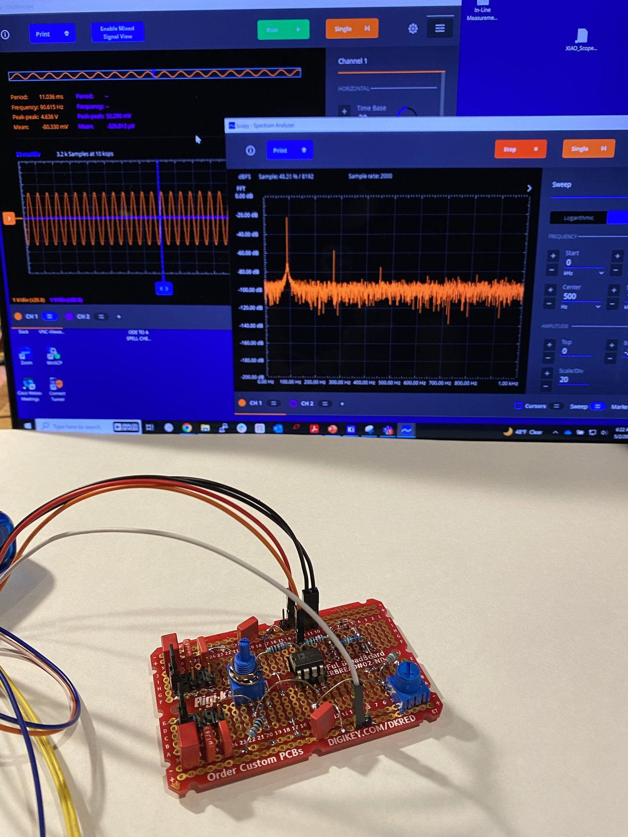
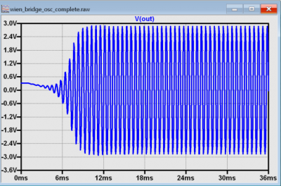
You can build a… “functional” one!
https://wiki.analog.com/university/labs/wien_bridge_osc_adalm2000
Notes:
https://wiki.analog.com/university/labs/wien_bridge_osc_adalm2000

Slide 22
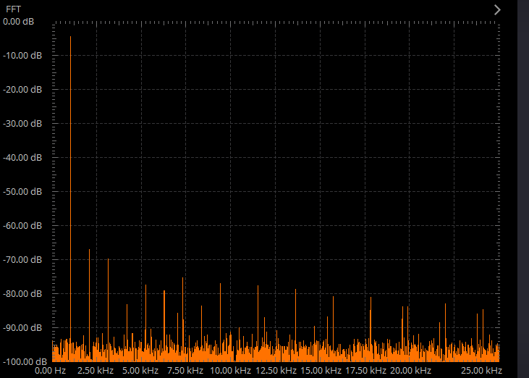
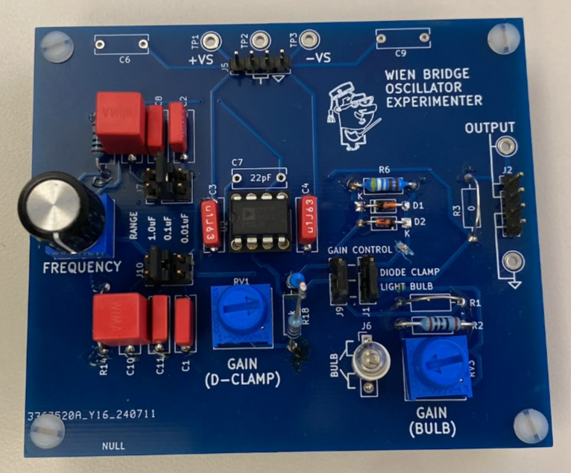
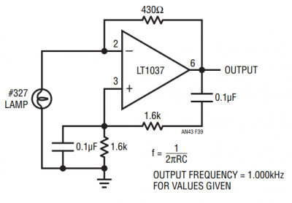
You can build a… pretty one!
PC board design on GitHub
Two different gain control methods:
Antiparallel diodes in feedback path
Light bulb (AN43, Figure 39)
0.1% distortion without even trying ☺
Notes:
I promise I’ll get the files up on GitHub soon, likely here:
https://github.com/analogdevicesinc/education_tools/tree/master/experiment-boards

Slide 23
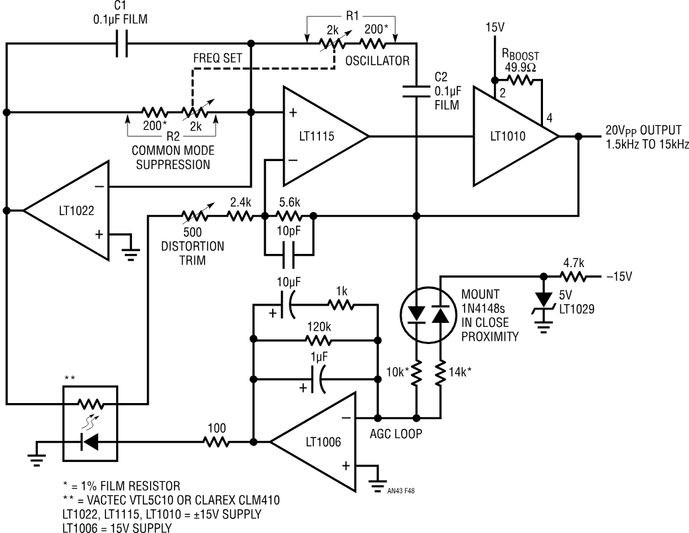
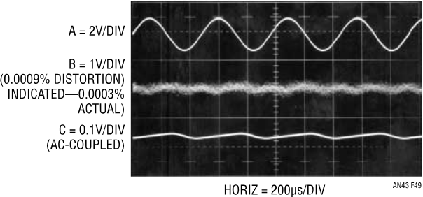
How much distortion if you DO try?
AN43 “Bridge Circuits”: Wonderful read for analog afficionados, describes the entire design process.
Figure 48: 3ppm distortion sinewave oscillator
Notes:
https://www.analog.com/media/en/technical-documentation/app-notes/an43f.pdf

Slide 24
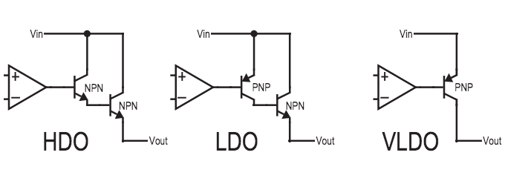



Linear Voltage Regulator? Yup, op-amp inside.

Slide 25


Cool Circuit you can build: Lorenz Attractor
Uses op-amps as analog computers
The URL says it all:
http://seti.harvard.edu/unusual_stuff/misc/lorenz.htm
Set of 3, coupled, nonlinear, first-order ordinary differential equations:
dx/dt = s(y-x)
dy/dt = rx-y-xz
dz/dt = xy – bz
suggested parameters:
s=10, r=28, and b=8/3
Notes:
http://seti.harvard.edu/unusual_stuff/misc/lorenz.htm

Slide 26


Lorenz Attractor Demo
I can’t do any better than Sariel Hodiasan’s article ☺ (link in notes)
https://github.com/Sariel-Hodisan/Chaotic-Circuits
https://www.youtube.com/watch?v=GajteYSNTtU
Notes:
https://www.electronicdesign.com/technologies/analog/article/55131908/circuits-of-chaos-building-lorenz-chua-and-rossler-strange-attractors

Slide 27


And finally – an Op amp you can build
Guess what the 10-pin SIP in the centre of your op-amp experimenter is for ☺
Writeup and board design file links in notes
Notes:
https://wiki.analog.com/university/courses/electronics/electronics-lab-13
https://github.com/analogdevicesinc/education_tools/tree/master/experiment-boards/transistor-op-amp

Slide 28

Thank You!
Questions?
Email: mark.thoren@analog.com

Slide 29
Link Dump
Op Amp education library search:
https://www.analog.com/en/search.html?query=operational%20ampifiers&resourceTypes=Education&page=2
Op Amp Applications Handbook, 2005:
https://www.analog.com/en/resources/technical-books/op-amp-applications-handbook.html
MT-037 Op-Amp Offset Voltage:
https://www.analog.com/media/en/training-seminars/tutorials/MT-037.pdf
Philbrick Apps Manual:
https://www.analog.com/en/resources/technical-books/applications-manual-computing-amplifiers.html
Philbrick Archive: www.philbrickarchive.org
Mini-Convectron gauges: https://www.mks.com/f/275-mini-convectron-module

Slide 30




Simple op-amp test case (you’re about to do more!)
Use scope, signal generator to test op-amp in gain of -2
Switch over to Scopy’s (Or Red Pitaya) network analyzer to measure bandwidth, stability
Discrete op-amp design at: github.com/analogdevicesinc/education_tools

Slide 31


Digression: Why is it called “Random Access Memory”?
Why not just “Memory”?
Early memories were sequential access! You had to wait for the bits to travel down a wire or tube of mercury until the one you wanted showed up, then you read it.
https://talk.dallasmakerspace.org/t/friden-132-electronic-calculator-with-acoustic-memory/30542
Moral: Study history, it’s fascinating.

Slide 32


uA741 (1968)
Original uA709 DIP pinout
Unity gain stable
Good all-around functionality
Still relevant today
Homework: read the Wikipedia Operational Amplifier page (starring the 741):
https://en.wikipedia.org/wiki/Operational_amplifier
Notes:
Who has used one of these? Unity gain stability made this the first truly general purpose opamp. For a very long time this was the defacto standard opamp pinout.
Benefit – you could swap different opamps into a socket to see which one worked best

Slide 33
Other Classics
uA709 (1965)
LM101A (1968)
LM108 (1969)
LM324 (1972)
LF356 (1974)
OP07 (1975)
TL071 (1978)
OP27 (1980)
LT1013 (1983)
LT1028 (1987)
LTC1050 (1991)
Notes:
Fairchild uA709: first to use the standard opamp pinout (but not unity gain stable) (Bob Widlar)
National LM101A: first to use PTAT bias – much more stable over temp (Widlar)
National LM108: first superbeta (Widlar): much lower input bias currents
National LM324: first “single supply” with CMR to ground at input. Spent many years as the industry’s generic quad opamp (Rod Russell)
National LF356: first JFET inputs
PMI OP07: first low-offset with trimmed inputs (George Erdi)
TI TL071 (also 072/074 dual and quad): low-cost JFET, defacto audio opamp for many years (runner-up: Signetics NE5532)
PMI OP27: lowest noise at the time (eN = 600ohms) (Erdi)
Linear LT1013: full performance with a single 5V supply (Carl Nelson)
Linear LT1028: <1nV/rtHz (eN < 50ohms) (Erdi)
Linear LTC1050: first chopper with standard pinout (internal chopper caps): real opamp with <10uV offset (Sevastopoulos)

Slide 34
Modern Classics
LTC6247: tiny (2x2 DFN dual)
LTC6090: high voltage (140V total)
LT1210: high current (1.1A out)
LTC6256: low voltage (1.8V total)
LTC6268: low bias current
LT6015: all-purpose
Notes:
Details on the next few slides

Slide 35
LTC6247
Dual in a tiny 2x2 package
Rail-rail input and output
180MHz GBW, 90V/µs slew rate, 1mA Iq
Otherwise a normal op amp
Notes:
Real no-excuses op amp in a tiny package

Slide 37
LTC6090
±70V supplies or 140V single supply
Rail-rail output
Otherwise a normal op amp
Notes:
Huge supply rails, otherwise a normal amplifier (this becomes a theme)

Slide 39
LT1210
High output power
1.1A output current
±15V supplies
11W output power
Current feedback architecture
Super-wide operating temperature: -40°C to +200°C
Notes:
Lots of output power (note the package). Current feedback architecture – anyone know what that is? (negative input is an output)

Slide 41
LTC6256
Operates on ±0.9V or 1.8V single supply
Rail-rail input and output
6.5MHz GBW, 65µA Iq
Otherwise a normal opamp
Notes:
Tiny rails, otherwise…

Slide 43
LTC6268
I_{B} = 3fA ≈ 19,000 electrons/s
i_{N} = 5.5fA/√Hz, e_{N} = 4.3nV/ √Hz
5V single supply
Otherwise…
Notes:
Virtually no bias current with reasonable ESD protection. Previous “electrometer” parts were shipped with the inputs tied together

Slide 45
Desert Island Op Amp
If you could pick only one…pick the LT6015
Rail-rail output
Way more than rail-rail input
Reverse voltage protection to -50V
Otherwise…
Notes:
Over-the-top. This one does it all.

Slide 47

Chopper Op Amps
Very low offset voltage – on the order of 1uV
Thermocouple effects on the PCB cause more offset than this
“Chopper” refers to a particular circuit technique – most IC “choppers” aren’t actually choppers
Notes:
“Chopper” is an old DC-AC-DC technique from the vacuum tube days (invented to counter the huge temp drift as the tubes warmed up). Modern parts are actually “CAZ” (commutating auto-zero) amplifiers, but that name never caught on

Slide 48
History
ICL7650
First integrated zero-drift op amp
Usable AC performance
Null capacitors are external – non-standard pinout
LTC1050
Internal capacitors
Looks just like a normal op amp from the outside
LTC1150
1050 performance with ±15V supplies
LTC2050
1050 in a tiny SOT package
Notes:
ICL7650 (also 7652) are pre-Maxim Intersil designs

Slide 49
What’s Inside?
Notes:
1052 is a 7652 clone – but it has a really good datasheet - perhaps the best chopper tutorial for the layman

Slide 50
LTC2057
4µV max offset, 15nV/°C drift
200nVp-p DC-10Hz, 11nV/√Hz, DC-1kHz
Otherwise a normal op amp
Notes:
That’s the whole noise spectrum, including chopper feedthrough. Can you tell what frequency the internal clock runs at? (25kHz)

Slide 52
Still Curious?
Many Op Amp Application Notes:
http://www.linear.com/doclist/?ci=1009&dt=2
Example Op Amp circuits:
http://www.linear.com/solutions/operational_amplifiers_(op_amps)?type=circuit
How Choppers work:
http://cds.linear.com/docs/en/application-note/an09f.pdf

